Slide 1
Quebec & Federal elections
https://www.youtube.com/watch?v=-1eP6RzORGA

Slide 2
Reminder: Political Parties & Party systems
Political Party: An organization that seeks to have its members occupy positions within the executive and legislative of government
  Can be rooted in social movements or elites
  Strategically balances ideology and catch-all ability
Party systems can be defined as the pattern of competition among political parties
The party system is highly influenced by electoral rules, therefore to understand political parties and voting behaviour, you need to look into electoral systems...
… Which is what we will do this week.

Slide 3
(En Rappel) Explaining the party system: Les Lois de Duverger
institutions matter
Duverger’s law: The more proportional the system, the greater the number of “effective” political parties there will be.
Works on multiple levels:
political party incentives and campaigns
voters strategic choices

Slide 4
In Class: https://www.youtube.com/watch?v=rwy9lLiavts
Extra material:
How our system works: https://www.thecanadianencyclopedia.ca/en/article/electoral-systems
https://www.youtube.com/watch?v=Mr-93C176qI
Pros and cons of our system: https://cpb-ca-c1.wpmucdn.com/myriverside.sd43.bc.ca/dist/a/42/files/2019/05/Electoral-Systems-FPTP-vs-PR-1.pdf
Ranked Ballot: https://www.cbc.ca/news/politics/ranked-ballots-pros-cons-1.3721696
Proportional Representation (Green party): https://www.greenparty.ca/en/democracy/read-more

Slide 5
Questions about anything election related ?
https://aceproject.org/
What is voting age in Brazil ?
Is it mandatory to vote in Belgium ?
What electoral system has Madagascar ?

Slide 6
Why do electoral system impact the party system?

Slide 7
Canada’s Electoral System
Single member plurality (SMP): country divided into ridings, with one elected representative (MP) per riding;
One election per riding following first-past-the-post system (the candidate who receives the most votes within each riding wins; no need to get more than 50% of the votes to win), with no proportional representation;
Provincial seat allocation related to population, but PEI is guaranteed 4 seats, and NB, 10 seats; the three territories receive one seat each (see map in Malcolmson et al: xvi).
In each province, federal electoral boundaries are redrawn every 10 years by a three-people commission (see Courtney 2001).

Slide 8
Fixed Election Dates and Electoral Reform
Adopted in 2007, fixed-election-date legislation states federal elections should take place every 4 years on the third Monday of October;
Yet, the electoral calendar is not set in stone because of the nature of parliamentary democracy, in which dissolution can occur at any time (for instance when the government loses confidence of the House);
Electoral reform: most widely debated alternatives to first-past-the-post are proportional representation (PR) and single transferable vote (STV);
Each system would have a different impact on the electoral fate of political parties (see Malcolmson et al: 191). Hybrid systems like the ones existing in Germany and New Zealand are widely debated in Canada.

Slide 9
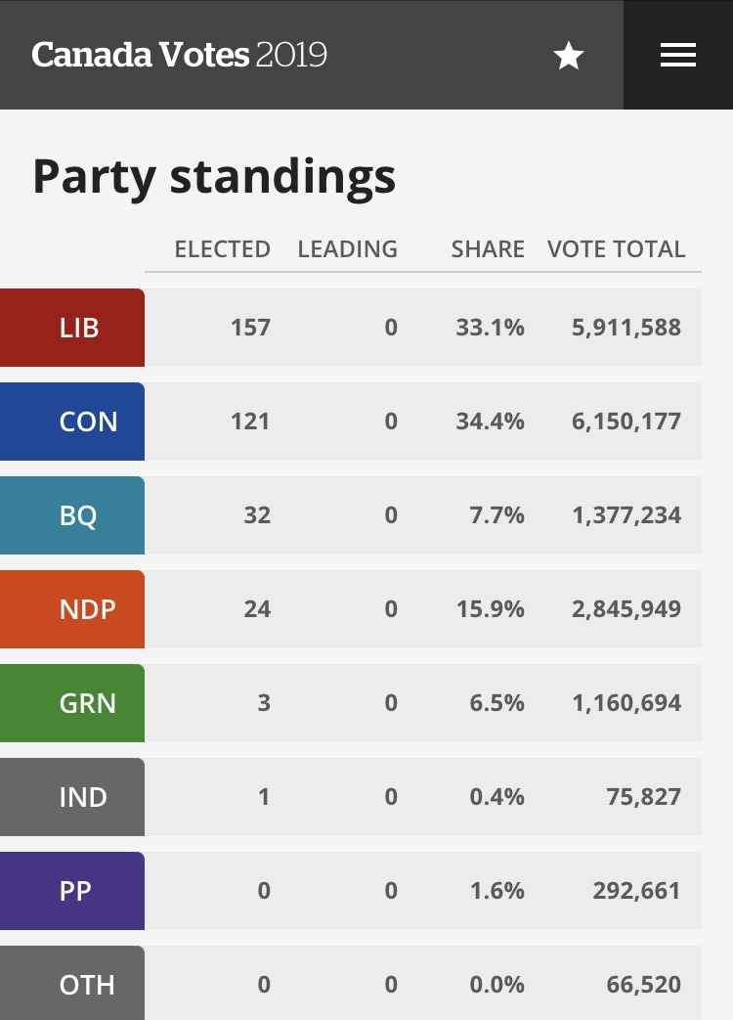

Slide 10
Why do electoral reform always fail ?
PEI, Ontario, BC in past 20 years.
Canada 2015
Quebec 2020

Slide 11
What are the alternatives?

Slide 12
4 systems, 4 results - 2019
https://ici.radio-canada.ca/info/2019/elections-federales/mode-scrutin-proportionnelle-mixte-compensatoire/index-en.html
first-past-the-post (current system), proportional representation (list system), mixed non-compensatory (e.g. Japan), and mixed compensatory system (e.g. Germany) systems.
PEI, BC, Canada, Quebec… why the constant failure of electoral reform attempts ?

Slide 13
Other interesting angles for your Op-Ed
  Gerrymandering
  Representativity issues and electoral reform
$ in politics
  Vast differences within Canada
  Better than the US…
  Third parties ?

