Slide 1
THE ETHICS OF CONSUMING ONLINE CONTENT
Jacqueline Rose on #metoo

Slide 2
Class discussion: What are some pros and cons of #metoo?
(Write notes as class contributes)
---
---
---
---
---
---
---
---

Slide 3
Jacqueline Rose, (born 1949 in London) is a British academic who is Professor of Humanities at the Birkbeck Institute for the Humanities. She is known for her work on the relationship between psychoanalysis, feminism, and literature. Rose is best known for her critical study on the life and work of American poet Sylvia Plath, The Haunting of Sylvia Plath, published in 1991. She is also a broadcaster and contributor to the London Review of Books, where the assigned article was published.

Slide 4
Read orally: excerpt from pg. 1 “I am a knife”
Should we look at this photo?
What does Rose mean when she asks “whether the endless photo spreads of [Weinstein’s] female targets weren’t so much designed to provoke outrage or a cry for justice as to grant the voyeur his pleasure” (pg. 1)

Slide 5
Read orally: excerpt from pg. 1-2 “I am a knife”
What does Rose mean when she writes:
“[W]hile the attention to violence against women may be sparked by anger and a desire for redress, it might also be feeding vicariously off the forms of perversion that fuel the violence in the first place.” (pg. 1-2)
“Harassment brings mental life to a standstill. It destroys the mind’s capacity for reverie.” (pg. 2)

Slide 6
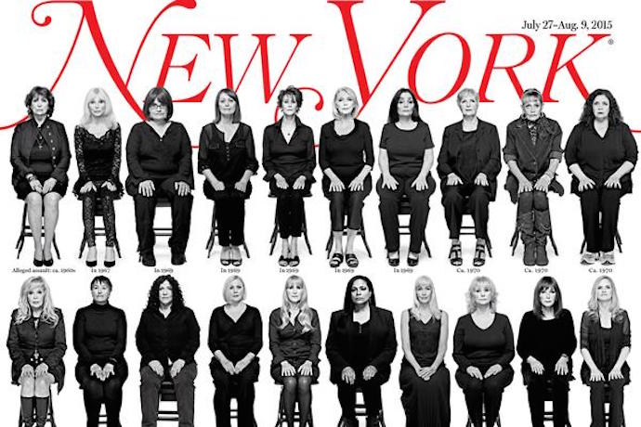
Read orally: excerpts from pg. 3-6 “I am a knife”
What is Title IX? (pg. 3)
What is the argument to link harassment and violence? (pg. 3)
What problems does Rose raise in the legal requirement for “clear and convincing evidence” in rape and sexual harassment charges? (pg. 4)

Slide 7
Should we look at this photo?

Slide 8
Small group assignment: Describe this photo in a new way. Write down your description to hand in for marks at the end of class.
There are 3 popular descriptions of this image.

Slide 9
Discussion questions:
What are the examples of the ways that the mainstream circulation of Black bodies perpetuates harm and violence?
What are some of the ways that “watching” racialized peoples contributes to our understanding of race?
Do you think visual images and videos can create or change “fixed ideas”?
What does the wide circulation of this image do to our fixed ideas about black men?
What is the point of a content warning? Do content warnings work?

