Slide 1
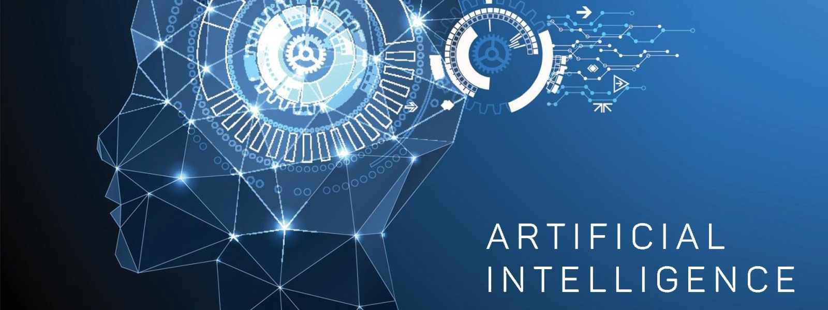
Social Problems: Sociology, Technology and Artificial Intelligence Applying Sociological Imagination to Innovation
Image:
ghananewsonline.com
Professor: Jennifer Sigouin, PhD
Lecture: Conflict Theory, Technology and AI

Slide 2
Outline
What is Conflict theory
The deskilling debate
Surveillance Society
The digital divide

Slide 3
Conflict Theory
Argues that society is grounded upon inequality and competition over scarce resources.
Two Basic Principles of Conflict Theory:
Power is the core of all social relationships, and is scarce and unequally divided among members of society
The powerful promote their interests at the expense of the weak
They maintain their control through the dominant ideology
Inequality is the original evil.

Slide 4
Marx (1818-1883) and Engels (1820-1895)
Work changed with capitalism
– so too did the means of production (e.g., technology) and the relations of production (workers vs owners)
In a capitalist economy there are 3 classes that are diametrically opposed:
1. Bourgeoisie (owns the means of production)
Proletariat ( exchange labour for wage)
Petite bourgeoisie ( small business owners) predicted that it will disappear

Slide 5
Marx (1818-1883) and Engels (1820-1895)
Two problems emerge in capitalism for the proletariat (worker):
Exploitation:
Treating someone unfairly in order to benefit from their work;
The difference between what workers are paid and the wealth they create.
On January 4, 2021, Canada’s top CEOs had already earned what most Canadians make in the entire year
2. Alienation: a condition of workers resulting from a lack of identity with the products of their labor, with their coworkers and society overall. Feeling of estrangement.

Slide 6
The deskilling debate
Are we experiencing enskilling or deskilling ?
Notes:
Textbook “Work, Industry, and Canadian Society” by Khran et al.

Slide 7
Daniel Bell (1973) The Coming of Post-Industrial Society
Among the first to note that we had moved out of the industrial era, which impacted occupations
Service-sector jobs will replace manufacturing.
Knowledge workers (professionals, technicians, scientists) = greater power in the postindustrial economy.
Knowledge economy
Argued that knowledge is difficult to hoard, so expect less social inequality and reduced conflict in the future.
Notes:
Textbook “Work, Industry, and Canadian Society” by Khran et al.

Slide 8
Braverman and Deskilling (Conflict theory)
Deskilling= process of reducing the level of skills required to carry out a job, which can also lead to the workers losing skills they used to have
Why: managers wanted to increase efficiency and have more control (same reasons as in factories).
= Degradation and future class conflict (just one working class), lack of control/autonomy over work process
BUT
Deskilling a universal pattern for all workers in all occupations?
Notes:
Textbook “Work, Industry, and Canadian Society” by Khran et al.

Slide 9
The Deskilling Debate
Clement and Myles (1994): net increase in requirements to think on the job so overall conclusion:
In North America and Western Europe= enskilling (increased skill requirements)
education
But:
Increased polarization between skilled workers and those with less skills who experience deskilling (impact the working class, might accentuate class differences)
Notes:
Textbook “Work, Industry, and Canadian Society” by Khran et al.

Slide 10
The Deskilling Debate
Deskilling in some occupations/work settings (lower tier-services); restaurants, cleaning
Multi-tasking (adding more tasks) versus multi-skilling (adding to the skill repertoire of workers)
Need new studies
Technology and AI: disappearance of certain jobs? (low-skilled, vulnerable groups)
Notes:
Textbook “Work, Industry, and Canadian Society” by Khran et al.

Slide 11
Chapter 11 textbook by Anabel Quan-Haase entitled “Technology and Society: Social Networks, Power, and Inequality
The Surveillance Society

Slide 12
Defining and Understanding Surveillance
The term surveillance has French roots meaning “watching over”
Surveillance by state and cies
Eradication of privacy, diminishing of individual rights, and unnecessary obsession with data
Data as free raw material for cies to anticipate needs and sell products, for government to anticipate and control behaviors
Data as commodity
Power and Control

Slide 13
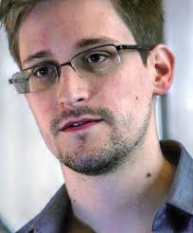
The Snowden Case
Edward Snowden, former contractor for the NSA, leaked classified material (thousands of top-secret documents about U.S. surveillance system)
The Snowden files provided direct evidence of surveillance programs in place in the U.S. to monitor not only foreign leaders, but also US citizens
Top-secret Prism program claims direct access to servers of firms including Google, Apple and Facebook. Big data is gathered via cellphone usage, social media and Internet activity
allows officials to collect material including search history, the content of emails, file transfers and live chats, phone numbers and duration of calls, access to communication without warrants
Whistleblower or traitor?

Slide 14
Why Disclose Personal Information Despite Privacy Concerns?
Online users are not fully aware of their vulnerability to privacy threats - “nothing to hide, nothing to fear”
Privacy becomes a concern only when it has been lost or breached

Slide 15
Why Disclose Personal Information Despite Privacy Concerns? cont’d
Voluntarily disclosing information known as information revelation.
Privacy paradox: Users report high levels of concern about the potential misuse of their personal data but continue to disclose large amounts of personal information online.
Solutions?

Slide 16
Activity: I am my data
I am asking you to pretend that you do not who you are..ha! Draw your profile based on the information you gather on the internet. What can someone or a company get to know about you based on an internet search?
1. Go on your Facebook profile, Parameters, your Facebook info. Request to have Facebook send you your Facebook information. Do this now as it might take a day to receive the information.
2. Go on Google and search your name. Anything? You should log off of any account you might have (e.g. IG, Facebook).
Search for your name on Facebook, Instagram, LinkedIn, etc.. Write down what one can know about you.
3. Look at the content that Facebook sent you. Look specifically at:
ads and businesses- Your off Facebook activity, Advertisers_who_uploaded a contact list with your information, Ads interest
Location: primary location
Profile information
So, what can one know about you based on an internet search? Provide a reflection on your findings.

Slide 17
Chapter 6 textbook by Anabel Quan-Haase entitled “Technology and Society: Social Networks, Power, and Inequality”
Technology and Inequality

Slide 18
Why Study Technology and Inequality?
Understanding technological inequality is important to researchers, policy-makers, and politicians because technology provides educational, political, and economic advantages, creating power imbalances and potentially conflict between social groups.
Key issues to consider include the social, economic, and cultural consequences for those not connected to the Internet.

Slide 19
The Digital Divide
The digital divide describes the differences between social groups in access to, use of, and empowerment by networked computers and other digital tools.
The gap between haves and have-nots is also evident in a range of digital tools including cellphones, laptops, tablets, and e-book readers.

Slide 20
Components of the Digital Divide
Five central components of the digital divide :
Access divide
Skills divide
Economic opportunity divide
Democratic divide
Social media divide

Slide 21
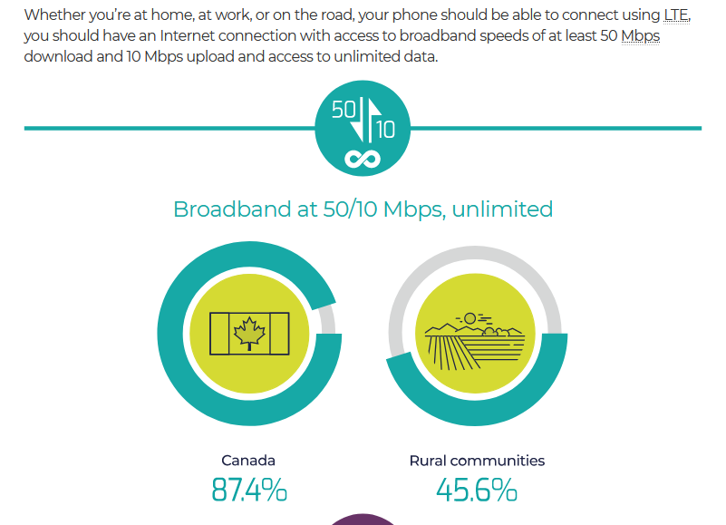
1. Access Divide
The access divide examines:
whether or not a person has access to the Internet
type of access
location
frequency of use
COVID is worsening the digital divide.
“According to the CRTC, nearly 86 per cent of households overall have that level of service currently, but in rural areas only 40 per cent do. In First Nation communities, it's estimated that just 30 per cent of households have internet connections with the recommended speed. ”(Stewart, CBC. 2020)
Source: CRTC, https://crtc.gc.ca/eng/internet/internet.htm
Notes:
https://www.cbc.ca/news/canada/british-columbia/covid-19-highlights-urban-rural-digital-divide-1.5734167
https://www.cbc.ca/news/canada/british-columbia/covid-19-highlights-urban-rural-digital-divide-1.5734167

Slide 22
Case Study: First Mile Project
To improve connectivity, different strategies have been proposed to increase First Nations people’s inclusion in the networked society.
According to McMahon (2014), the First Mile project is an approach that focuses on “ways that public policies, regulations, and other supports enable user communities to generate and sustain their own networked digital infrastructures” (p. 4).
The First Mile project was developed from 2012 to 2013 and is now part of the First Nations Innovation project (https://fn-innovation-pn.com/first_mile.aspx)
OCAP principles (refers to ownership, control, access and possession) are applied:
“First, that First Nations must retain access and possession of the capacity and resources to effectively manage the content, traffic and services on their local network.”
“Second, that First Nations have a right to own and control the local broadband network in their communities in order to support the flow of information and services.” (First Nations Innovation Project Website)
Notes:
Reference: Schnarch, B. (2004) Ownership, Control, Access, and Possession (OCAP) or Self-Determination Applied to Research: A Critical Analysis of Contemporary First Nations Research and Some Options for First Nations Communities. Journal of Aboriginal Health, 1(1): 80-95.

Slide 23
2. Skills Divide
The skills divide is measured in terms of technical competence and information literacy in the digital world.
Technical competence: knowledge about how to use computers
Information literacy: ability to seek out information, evaluate it, and use it for specific purposes

Slide 24
3. Economic Opportunity Divide
The economic opportunity divide reflects beliefs and attitudes that individuals have about the advantage provided by access to digital technologies.
E.g., finding a job, obtaining health information, taking an online course

Slide 25
Dissecting racial bias in an algorithm used to manage the health of populations (Obermeyer et al., 2019)
Conducted a study which found that an algorithm widely used in US hospitals to allocate health care to patients has been systematically discriminating against black people.
Concluded that the algorithm was less likely to refer black people than white people who were equally sick to programmes that aim to improve care for patients with complex medical needs.
Only 17.7% of patients that the algorithm assigned to receive extra care were black. The researchers calculated that the proportion would be 46.5% if the algorithm were unbiased.
Algorithm based on total health care cost, but if practitioners are less likely to prescribe further tests to black people, then the algorithm reflects this systemic discrimination.

Slide 26
4. Democratic Divide
The democratic divide describes the use of the Internet for political engagement.
E.g., researching political information, making donations to political entities, and communicating with the government, political participation, keeping people at the top accountable.
E.g., Townhall Canada App

Slide 27
Ushahidi
A global tech company born in Kenya during the 2008 election that empowers people to raise their voices
Report any incidence of election tampering, violence
Citizen engagement: increase interaction between people and their government
Inclusive governance: marginalised groups have the chance to engage in governance processes
Open and responsive government

Slide 28
5. Social Media Divide
The social media divide is the gap that exists in adopting social networking sites (SNSs) along demographic variables such as gender, income, and education.
Recently it has been posited that SNS usage is not a waste of time, but it is tied to identity management (can recreate oneself), informational access, and the creation of social and cultural capital.

Slide 29
Cultural Capital and Social Media
Cultural capital describes the sum of intangible social assets that allow an individual to claim membership in specific social groups (Bourdieu, 1973).
Cultural capital allows individuals to show credibility and belong to social groups.
Knowing who to follow on Instagram, what music one needs to listen to, Netflix shows, latest gossip, etc…is part of cultural capital, how to be “in” (e.g., caring for the environment).

Slide 30
Cultural Reproduction Theory: Social Capital
The growth of social networks and relationships can result in a larger landscape of opportunity
The presence or absence of social networks
When applied to social media: # followers, #likes, YT: # of viewers, subscribers, can lead to income, career (influencers), can also provide friendship, support

